Slide 1

Saving Figures

Slide 2

Reference
Chapter 14 (O'Reilly) of Hands-On ML
Youtube
Code

Slide 3
Data

Slide 4
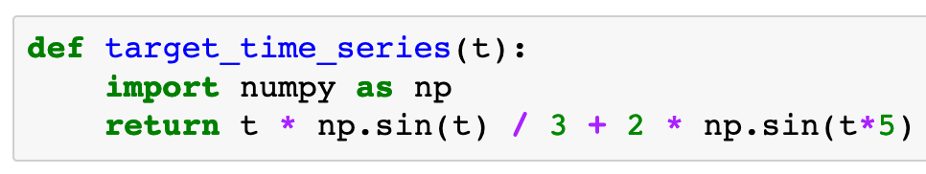

Slide 5
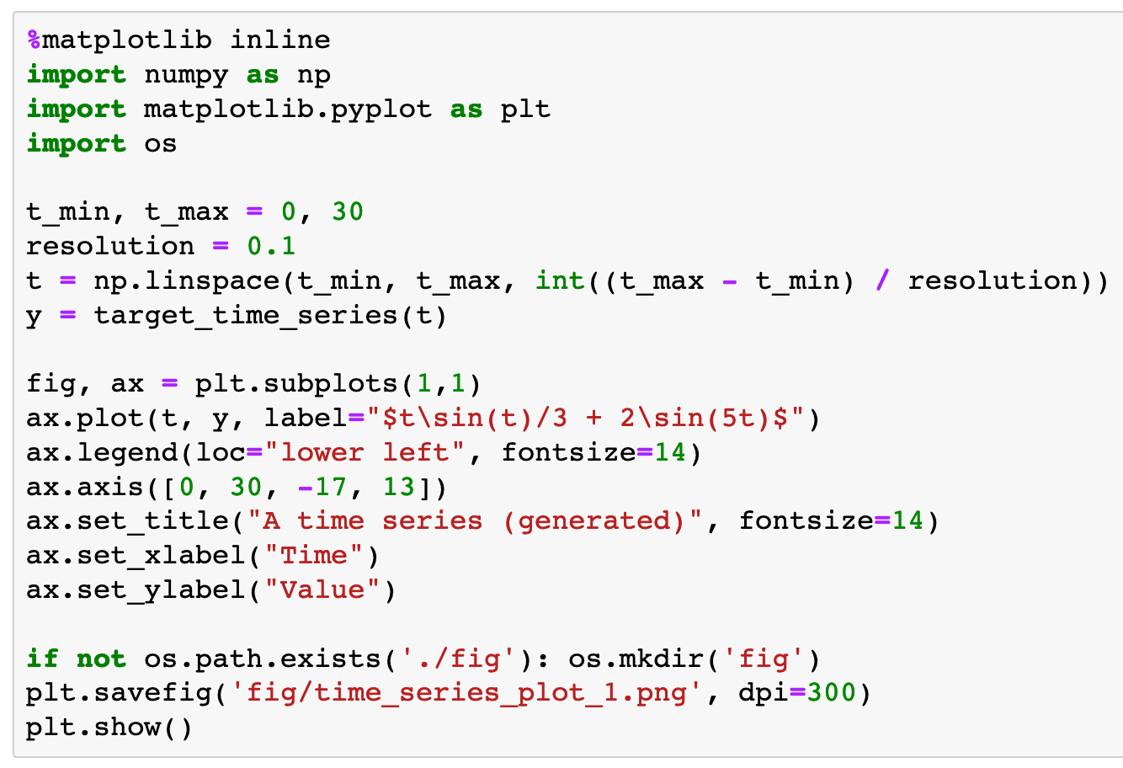

Slide 6
./fig path exists?

Slide 7
./fig path exists?
make directory

Slide 8
save figure

Slide 9
save figure
Dots Per Inch

Slide 10
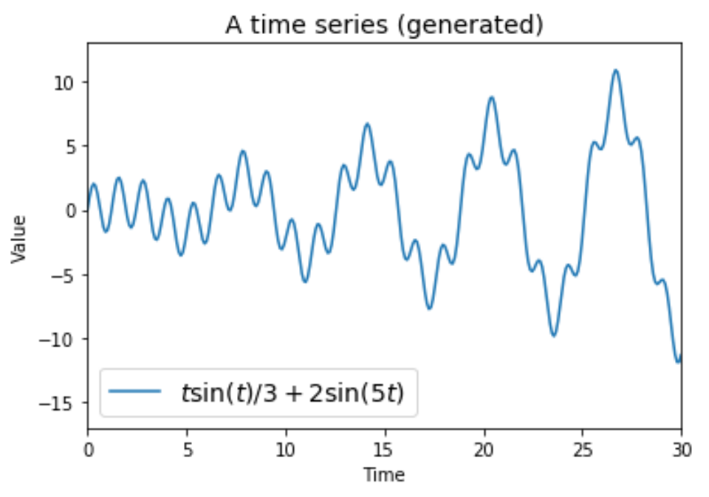

Slide 11
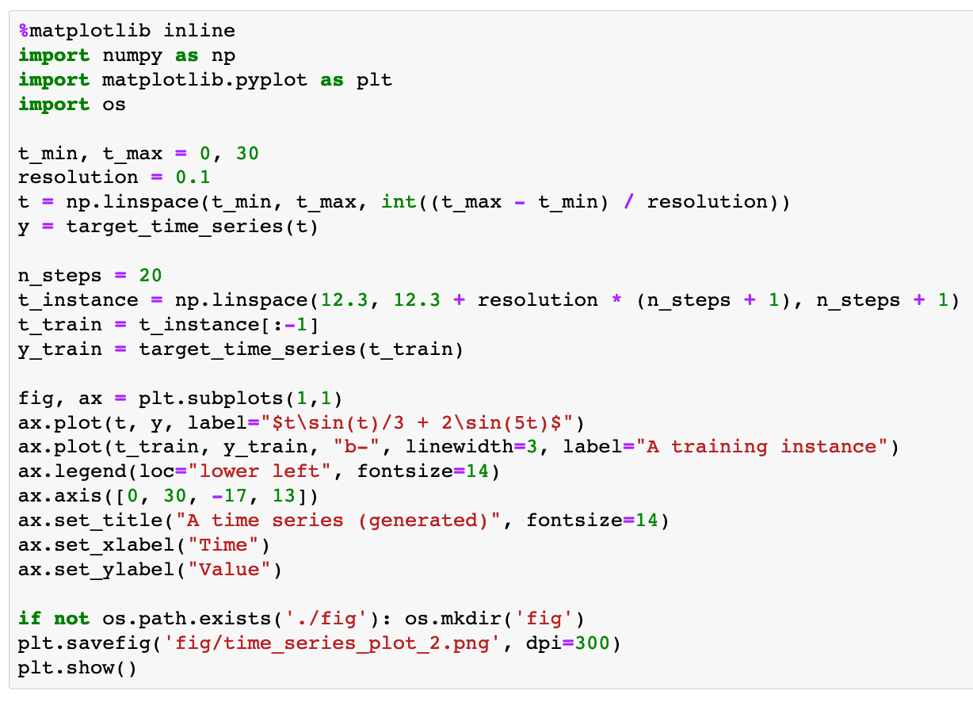

Slide 12
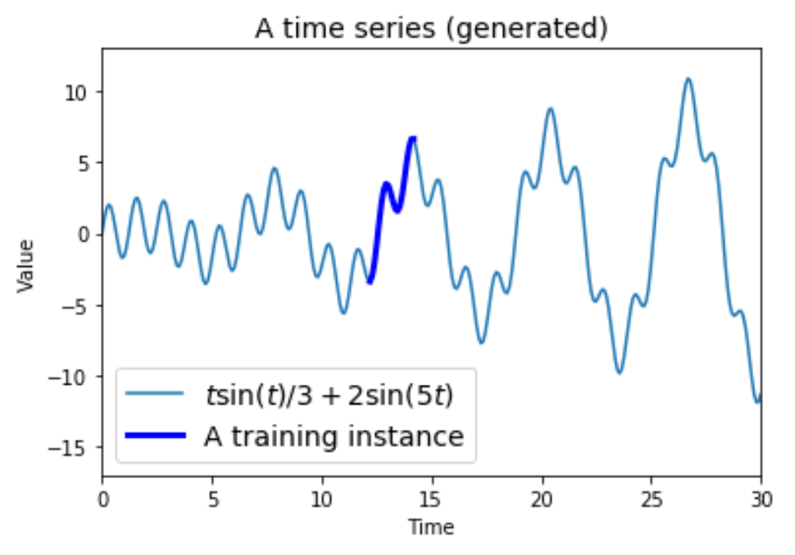

Slide 13
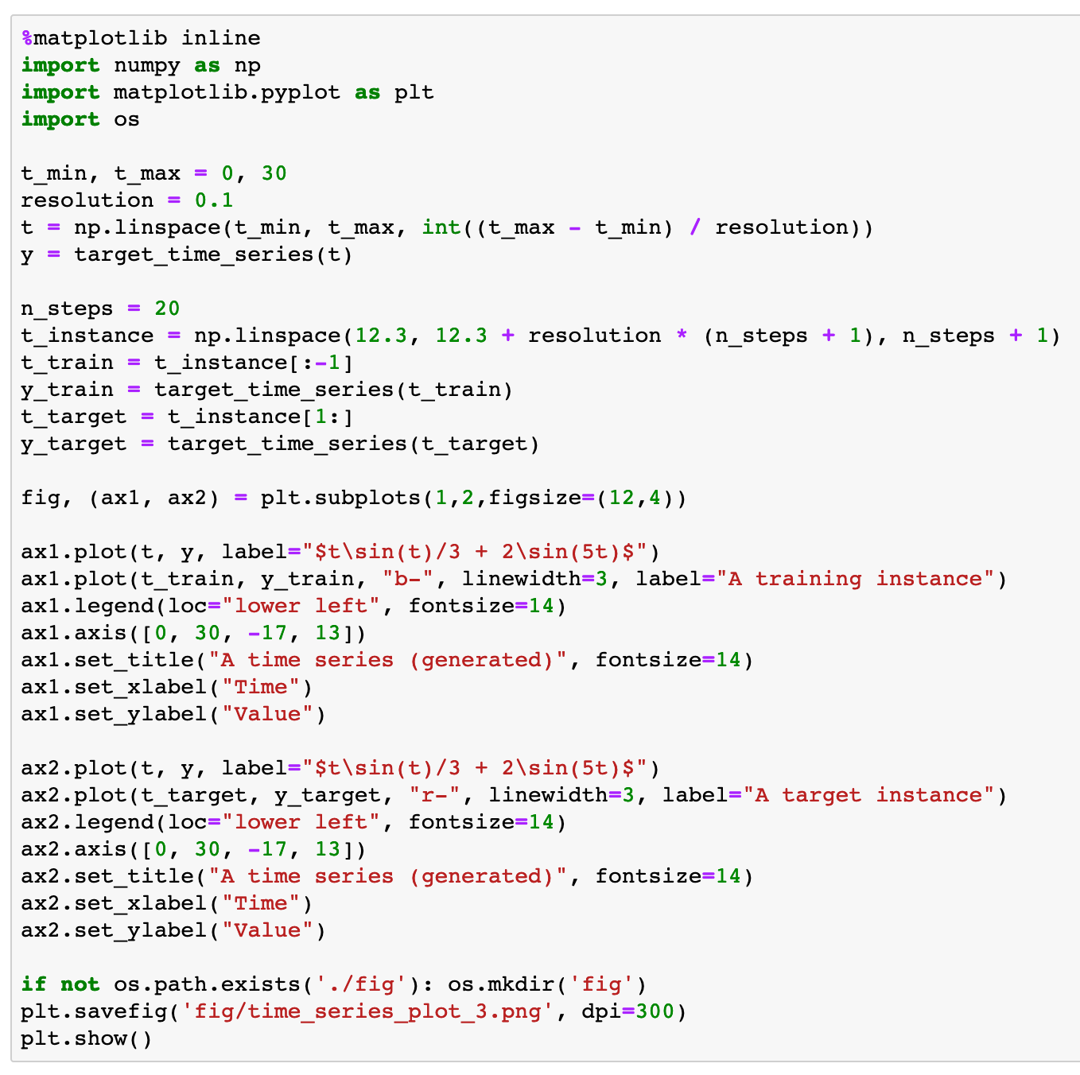

Slide 14
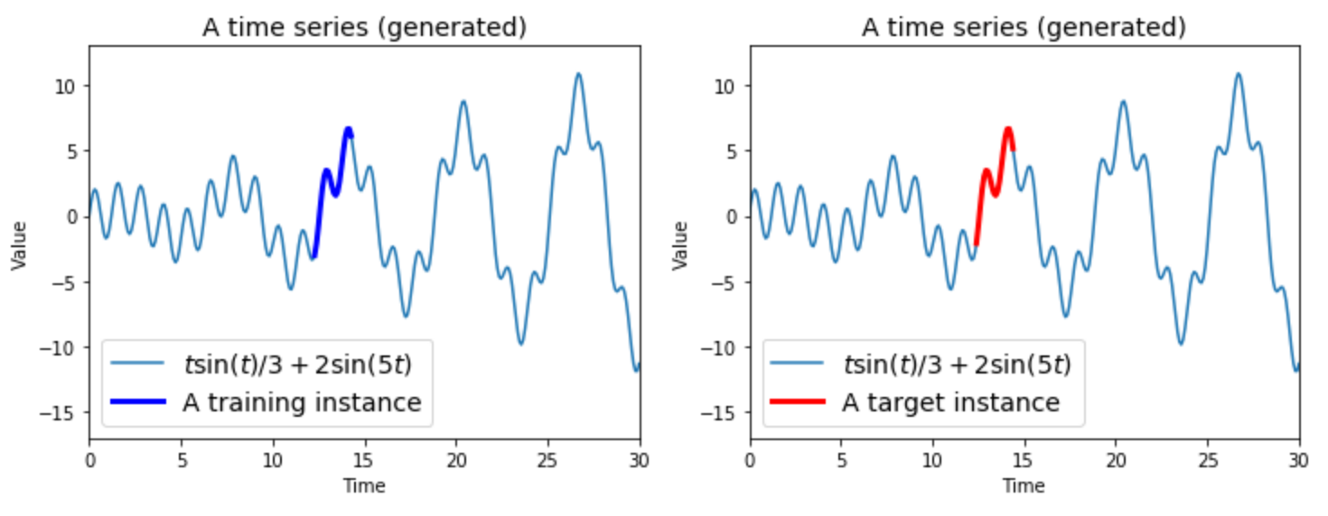

Slide 15
Now
Let’s Play with Code

